Slide 1
CV and Biosketch Writing
Aislinn Williams, MD, PhD
Writing Initiative for Neuroscience
Sept 3, 2019

Slide 2
What are the differences?
 | CV | Biosketch
Audience | Potential employers | Mentors and funding sources
Content | Organized lists for quick reference | Brief focused stories about your work, interests, and potential future impact
Structure | Variable Depending on the job you want, style will matter (even more true with résumés) Institutions have required templates | Standardized

Slide 3
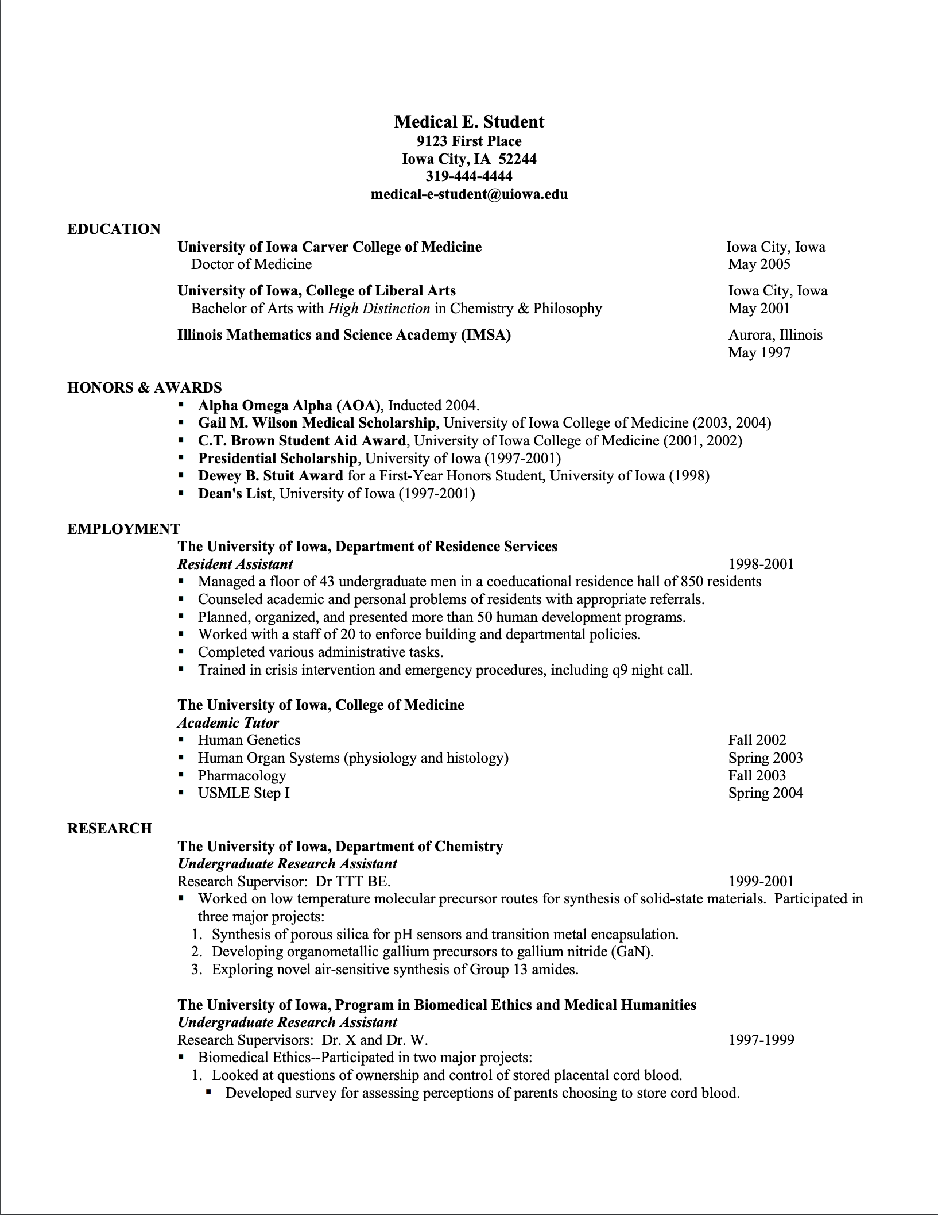
CV example

Slide 4
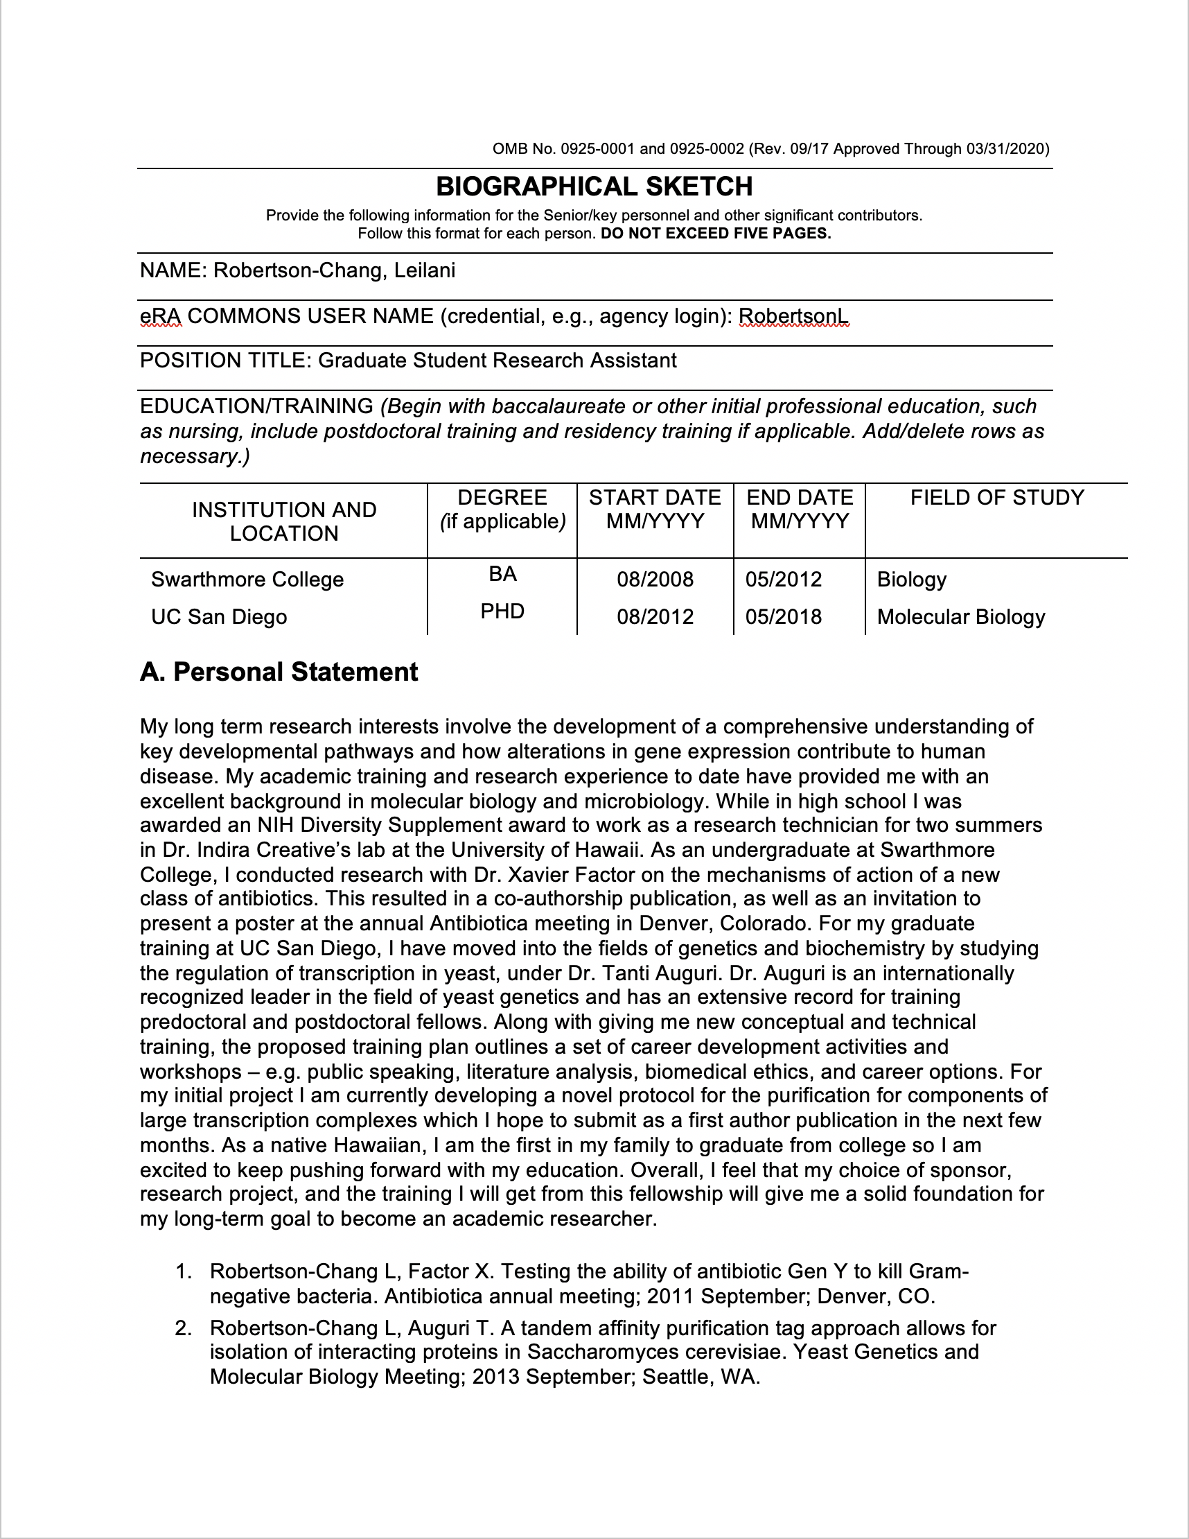
Biosketch example

Slide 5
Additional tips and resources
Read and follow the instructions
Always compare with others, especially those who got jobs or were funded
Alan Alda Center for Communicating Science:
https://www.aldacenter.org/aklc/build-skills/online-courses/aldablogging2017
Tell Me a Story, by Josh Sanes (eLife, 2019)
https://www.uab.edu/postdocs/images/PersonalStatementMakeoverforNIH.pdf

Slide 6
SciEnv
https://www.ncbi.nlm.nih.gov/sciencv/

Slide 7
Advance Questions from WIN
How often do you update your CV?
Every time I do anything or agree to anything
Dos and Don'ts of what to include in CV and Biosketch
Don’t include high school unless specifically requested
Don’t add sections that aren’t included in the provided template
How has your CV and Biosketch evolved as you have moved from a grad student to a post-doc to a PI?
How do you, as an employer, look at a CV?
I look for evidence that someone can do what they say they can do (rotations in specific kinds of labs, poster presentations, publications)

